Slide 1
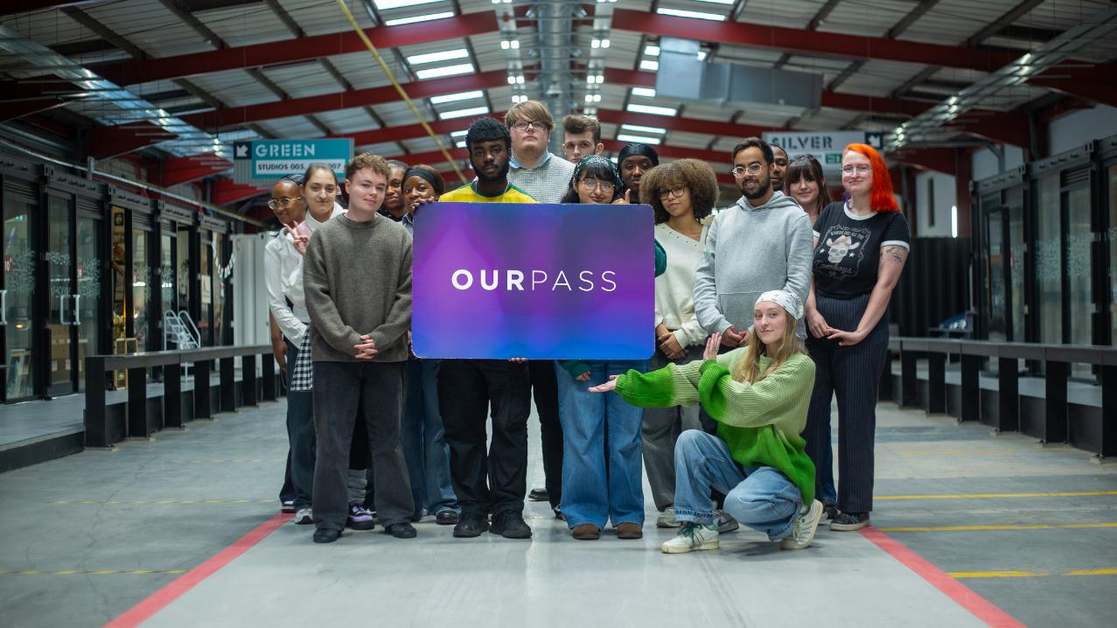

More than just a bus pass
Notes:
Please deliver this presentation to your Year 11 students before they officially leave school
The ‘Our Pass Applications 2026 - Schools Briefing Pack’ provides additional information and resources to enable you to inform your students about applying for Our Pass and support them with their applications.
Page 4 explains what Our Pass is, who’s eligible for Our Pass, and how they can apply.
Page 9 explains what your school can do to support your students with their applications.

Slide 2

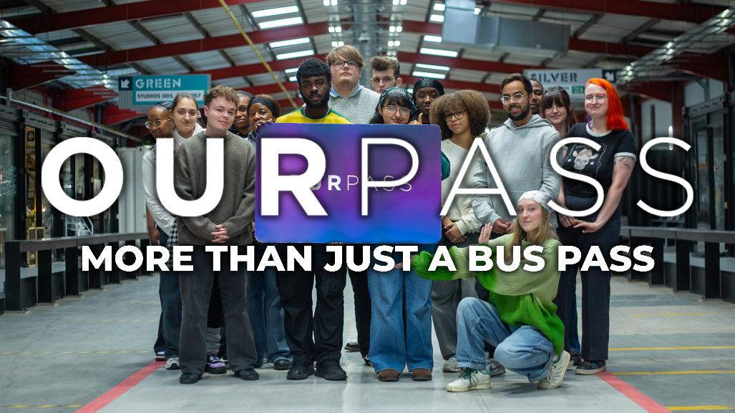
More than just a bus pass…
Notes:
Before showing this film, please check the hyperlink to our You Tube channel works and change the playback Quality setting to HD.
You can also switch on the Subtitles if this will be beneficial.
The video can also be found here: https://youtu.be/Jm4pjQWH7LQ

Slide 3
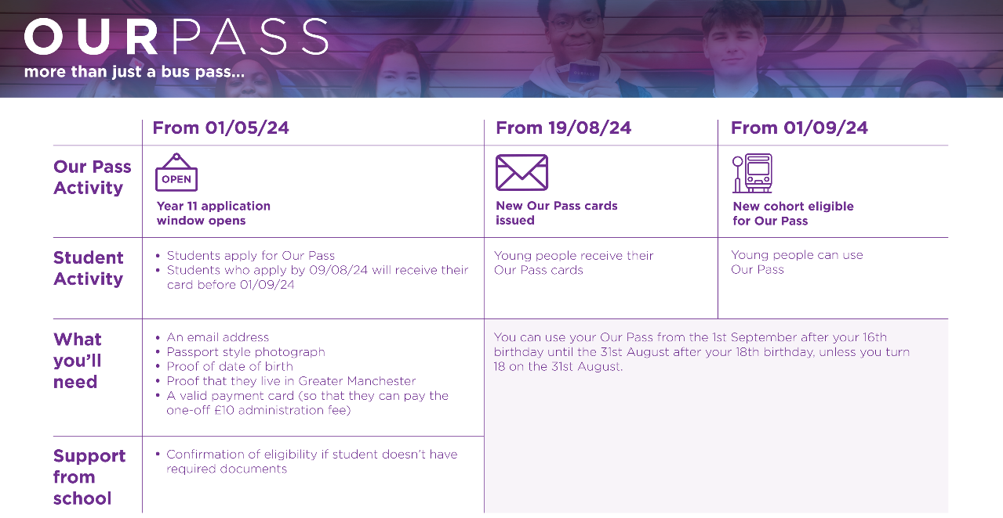


From 27/4/26
From 1/9/26
From 19/05/25
Year 11 application window opens
New cohort eligible for Our Pass
Digital passes become active in Bee Network app
Apply for Our Pass from 5/5/26
You can now use your Our Pass!
A smartphone
An email address
Proof of date of birth
Proof that you live in Greater Manchester
A valid payment card (so that you can pay the one-off £10 administration fee – this can be your parents or carers card with their permission)
Make the most of your access by registering for Our Pass Exclusives at ourpass.co.uk
Your school can help confirm your eligibility for Our Pass if you don’t have these documents
Notes:
Please talk through the application timeline.
Highlight that by applying early any issues with a student's application can be addressed before the August rush to ensure their Our Pass is ready to be used on the 1st September.
Highlight how the school can support your students with their applications, providing they apply before the end of term.

Slide 4



