Slide 1
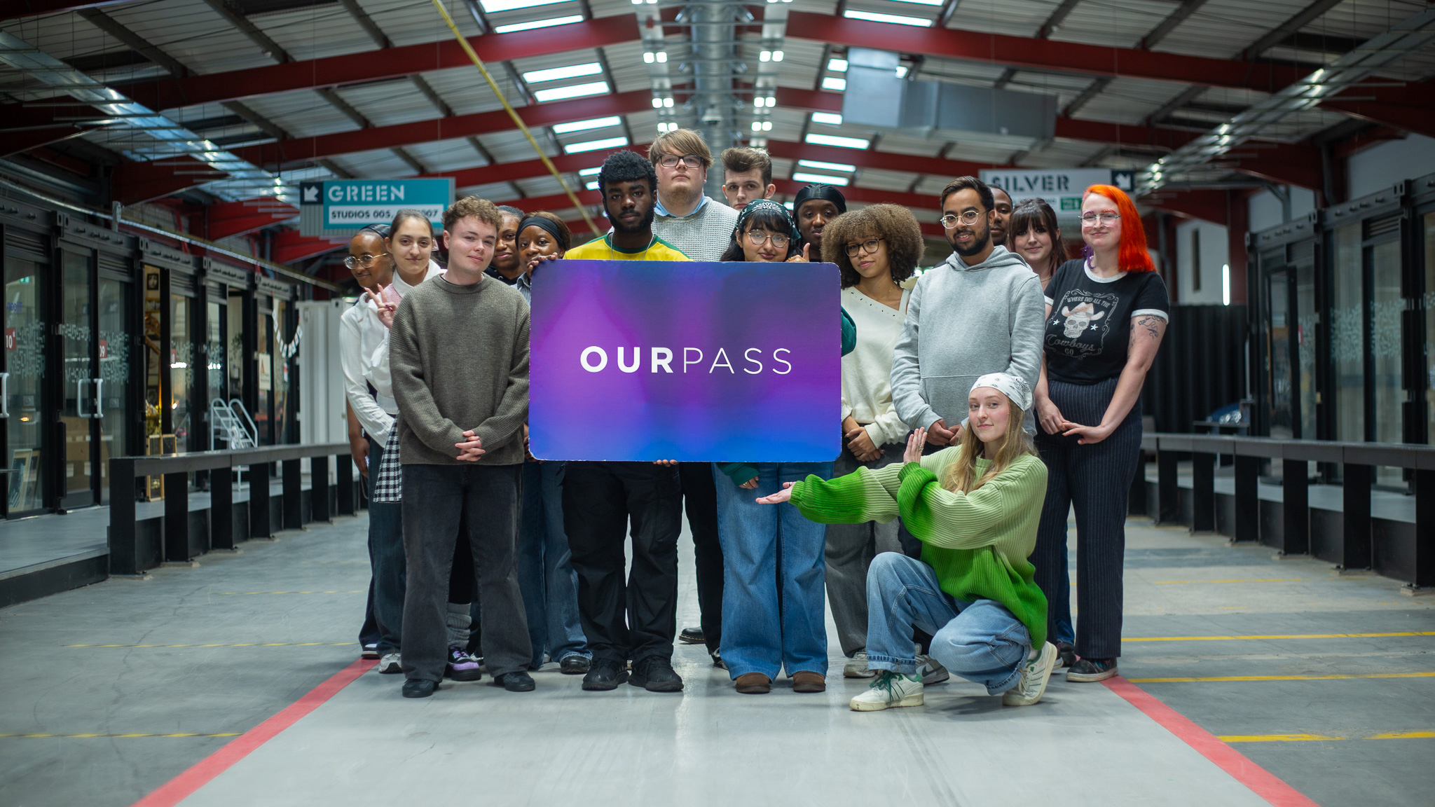



Slide 2

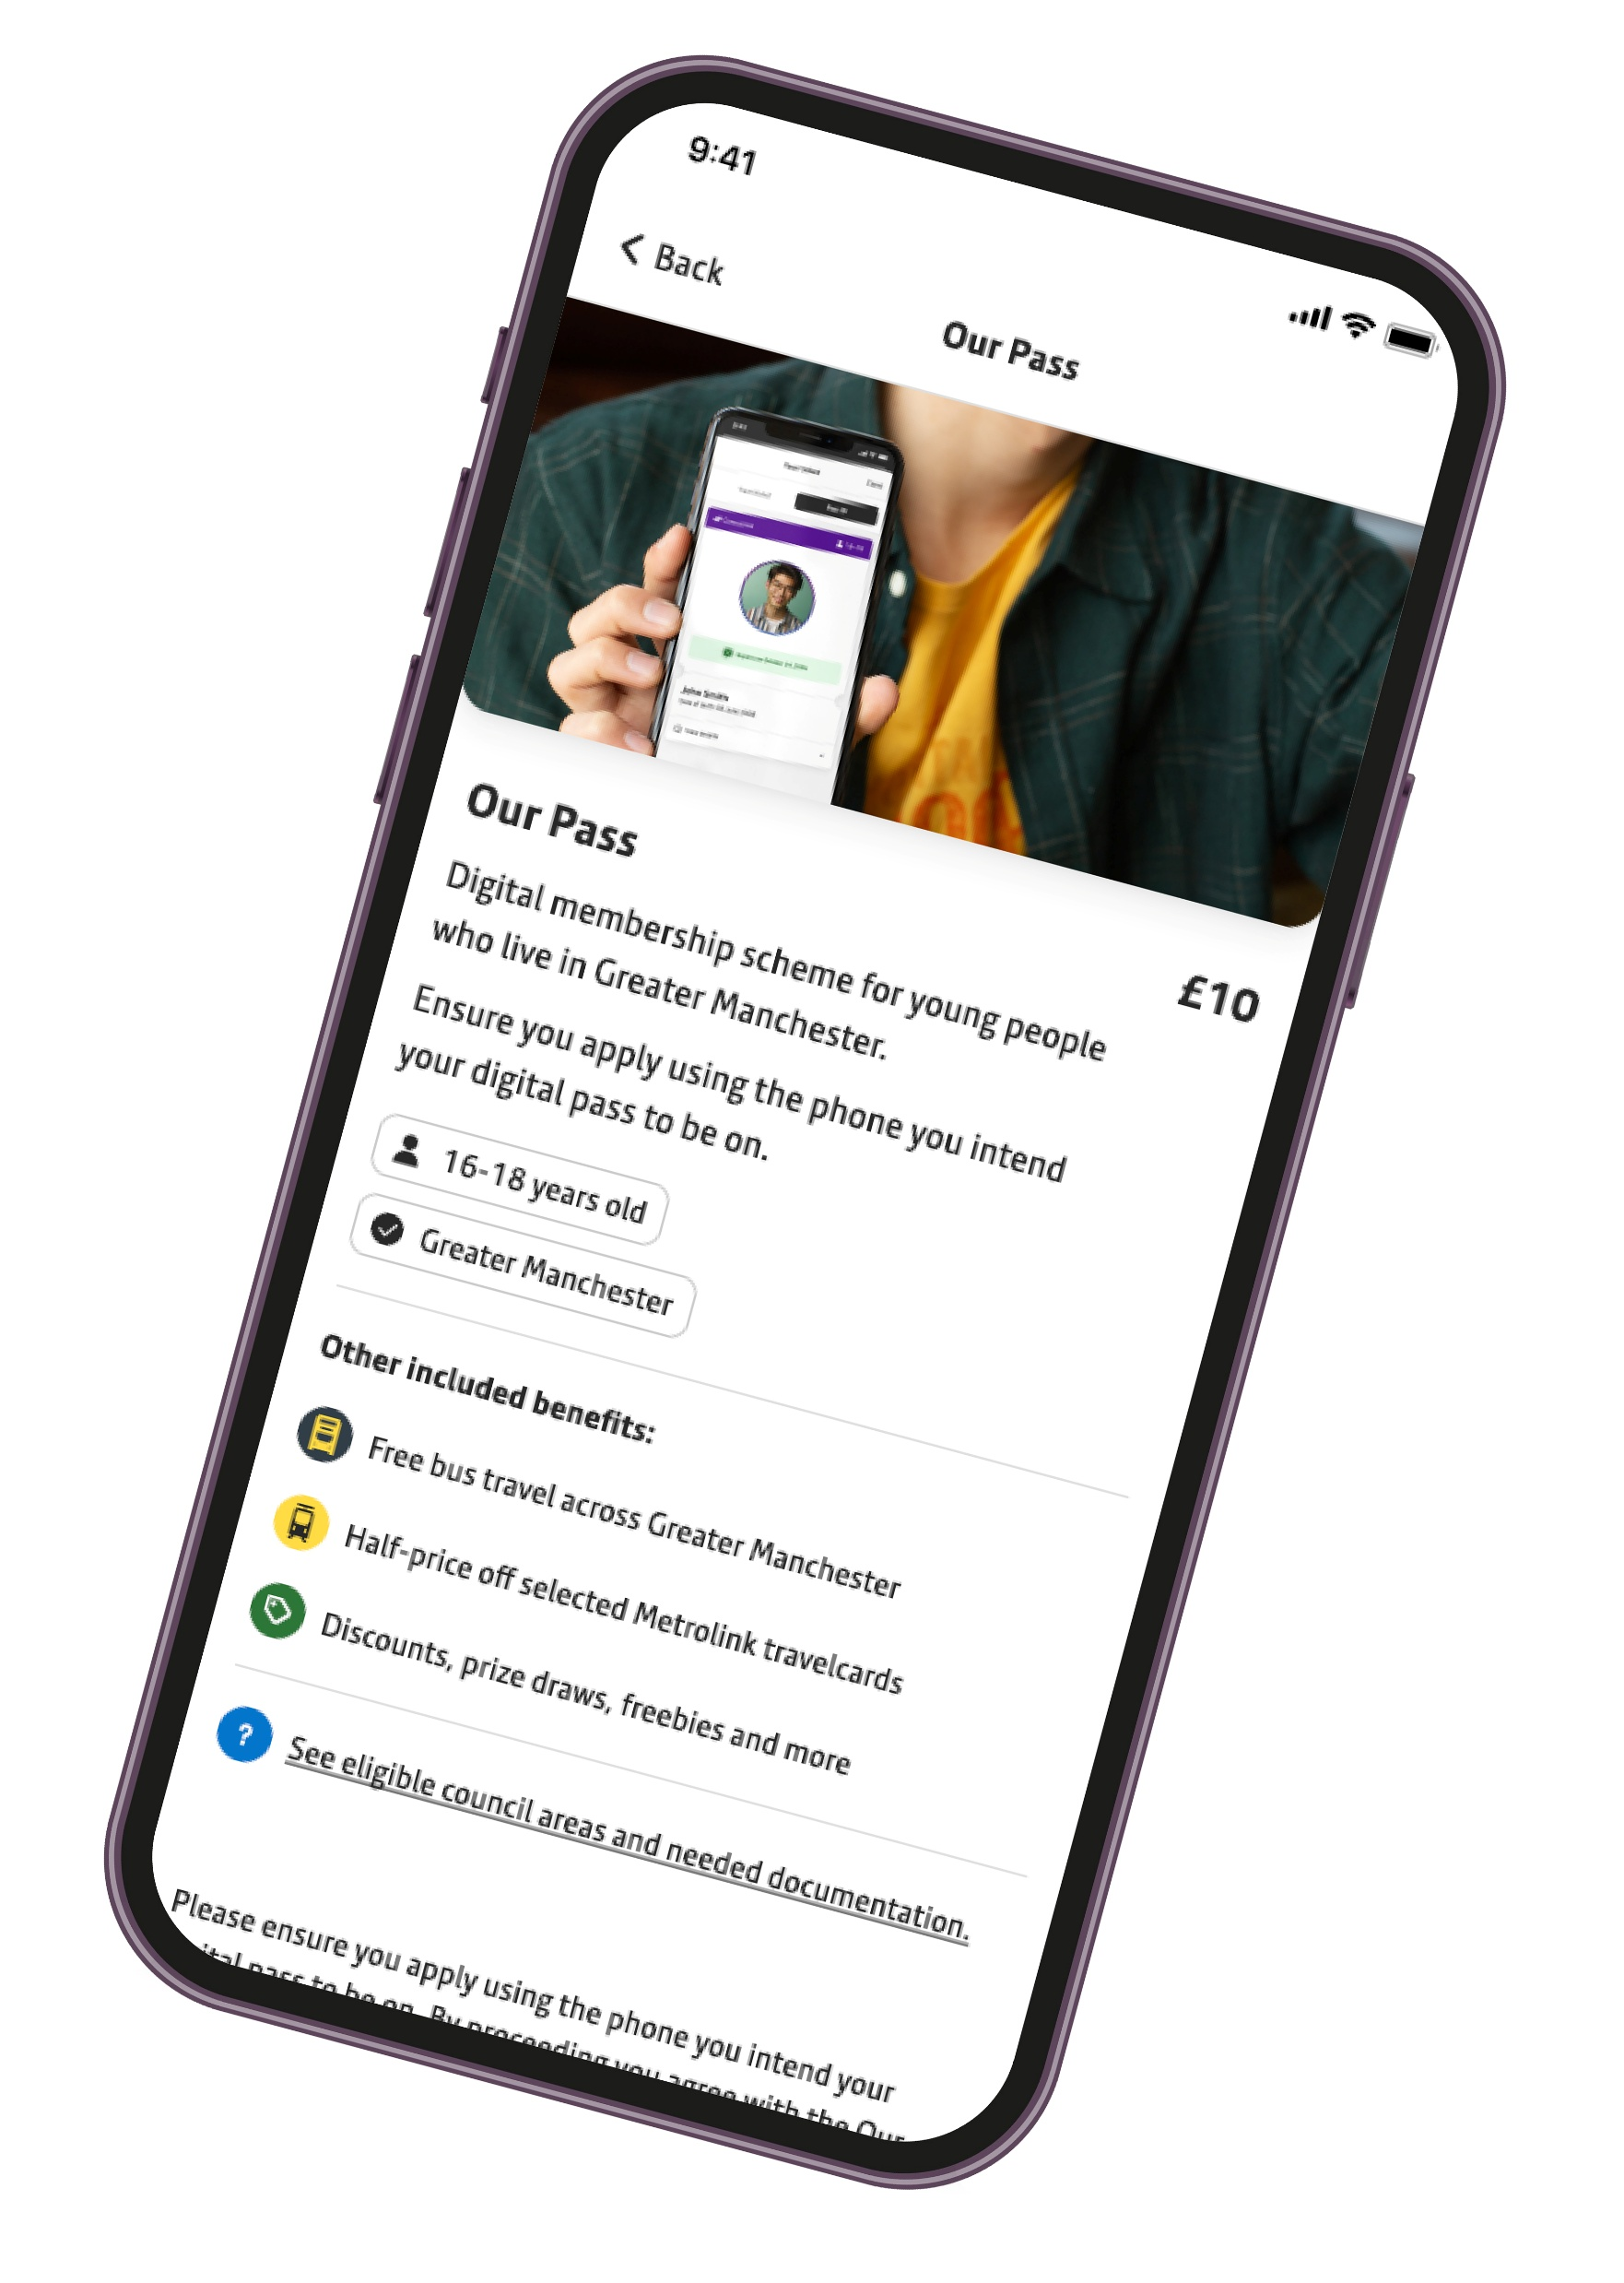
What is Our Pass?
Our Pass is more than just a bus pass …
Unlock Your Future with Our Pass Exclusives!
With Our Pass Exclusives, you can:
Explore exciting career paths and discover what you’re really passionate about.
Try out cool new activities — from creative workshops to adrenaline-packed adventures.
Get top discounts and freebies from big brands and local spots.
Whether you're chasing your dream job, finding your vibe, or just want to make the most of your city region — Our Pass Exclusives has got you.
And remember, with Our Pass, bus travel throughout GM is FREE and you can save £££ on Metrolink.
2

Slide 3




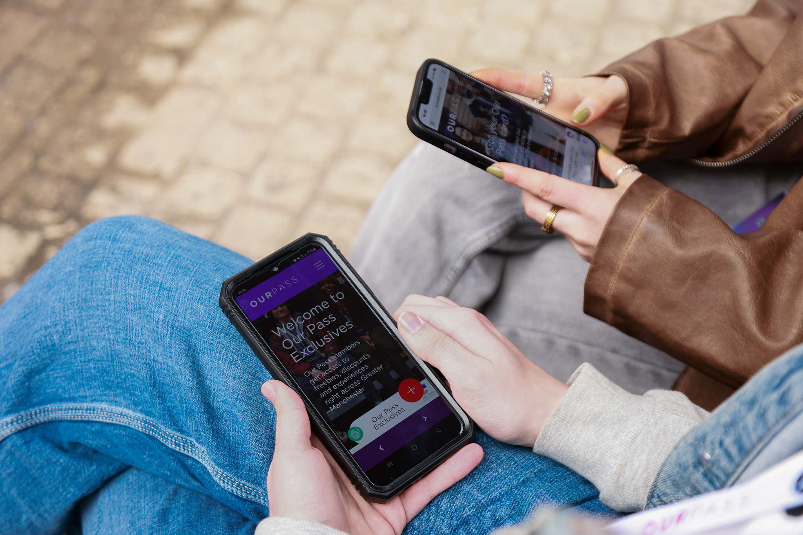







Our Pass Exclusives
3

Slide 4
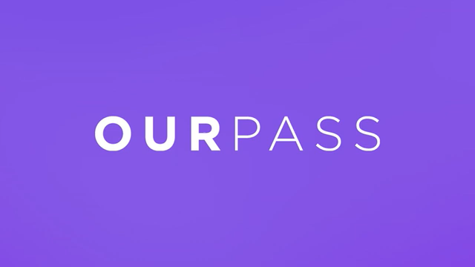
More than just a bus pass…
4
Notes:
Before showing this film, please check the hyperlink to our You Tube channel works and change the playback Quality setting to HD.
You can also switch on the Subtitles if this will be beneficial.
The video can also be found here: Our Pass; More Than Just A Bus Pass (2025) - YouTube

Slide 5
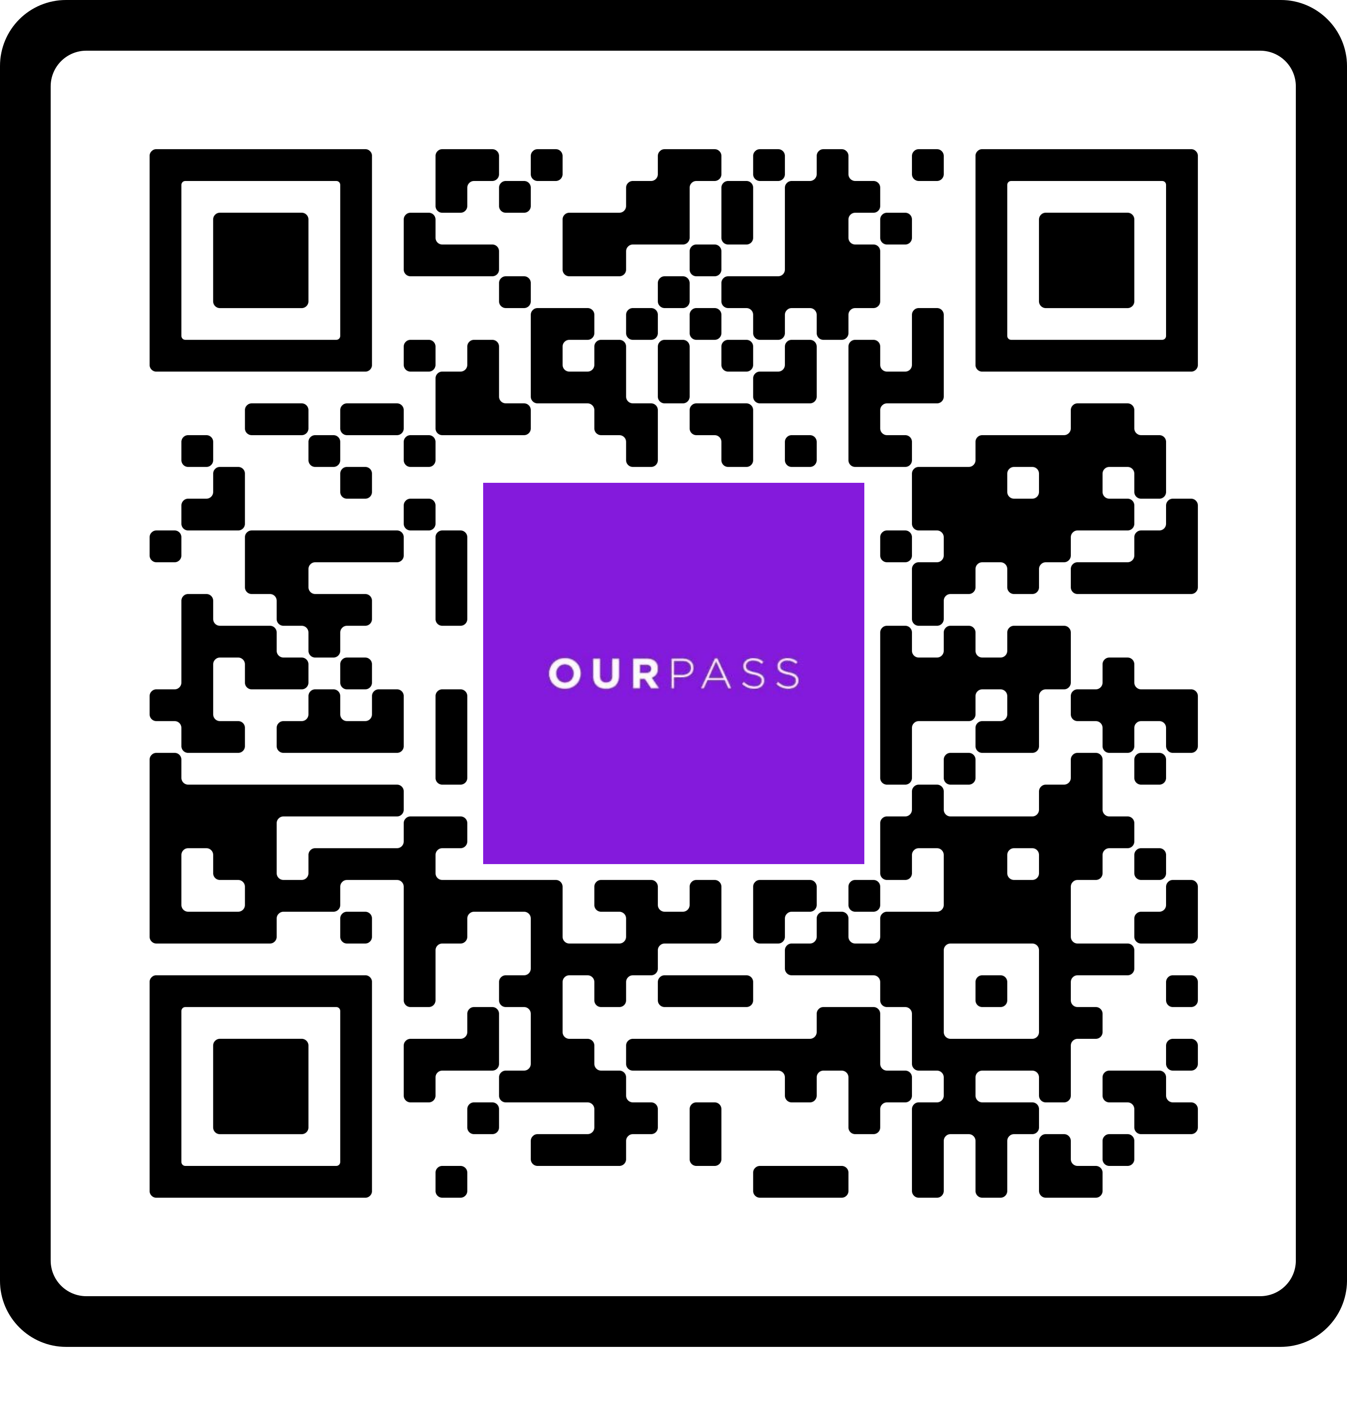
How do I get Our Pass Exclusives?
Aged 16-18 and live in Greater Manchester?
It’s as easy as 1, 2, 3!
Apply for Our Pass in the Bee Network app
When your Our Pass goes live register for Our Pass Exclusives at ourpass.co.uk
Start living your best GM life with everything Our Pass has to offer!
w: ourpass.co.uk
e: opportunities@ourpass.info
5

Slide 6


