Slide 1
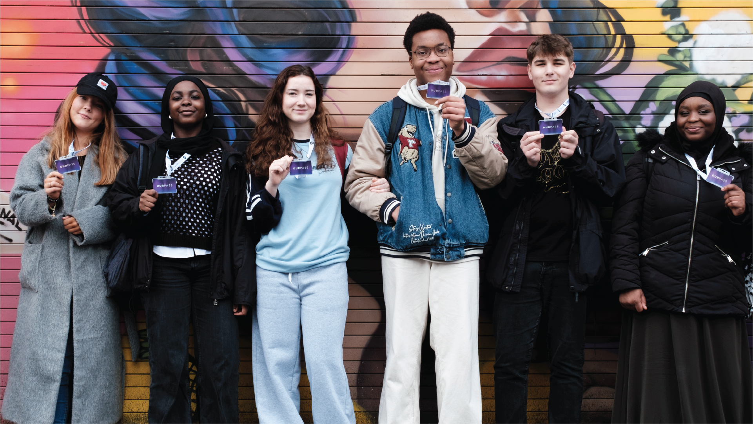
Notes:
Please deliver this presentation to your Year 11 students before they start study leave
The ‘Our Pass Applications 2024 - Schools Briefing Pack’ provides additional information and resources to enable you to inform your students about applying for Our Pass and support them with their applications.
Page 3 explains what Our Pass is, who’s eligible for Our Pass, and how they can apply.
Page 8 explains what your school can do to support your students with their applications.
You can download the Briefing Pack here: https://ourpass.co.uk/wp-content/uploads/2024/04/Our-Pass-Applications-2024-Schools-Briefing-Pack.pdf

Slide 2
More than just a bus pass…
Notes:
Before showing this film, please check the hyperlink to our You Tube channel works and change the playback Quality setting to HD.
You can also switch on the Subtitles if this will be beneficial.

Slide 3
Notes:
Please talk through the application timeline.
Highlight that by applying early any issues with a student's application can be addressed before the 9/08/24, to ensure they receive their card before the 1st September.
Highlight how the school can support your students with their applications, providing they apply before the end of term.

